Slide 1

Chapter 5:
Loops and Files

Slide 2

The Increment and Decrement
Operators
++ is the increment operator.
It adds one to a variable.
  val++; is the same as val = val + 1;
++ can be used before (prefix) or after (postfix) a variable:
  ++val; val++;

Slide 3
The Increment and Decrement
Operators
-- is the decrement operator.
It subtracts one from a variable.
  val--; is the same as val = val - 1;
-- can be also used before (prefix) or after (postfix) a variable:
  --val; val--;

Slide 4
Prefix vs. Postfix
++ and -- operators can be used in complex statements and expressions
In prefix mode (++val, --val) the operator increments or decrements, then returns the value of the variable
In postfix mode (val++, val--) the operator returns the value of the variable, then increments or decrements

Slide 5
Prefix vs. Postfix - Examples
int num, val = 12;
cout << val++; // displays 12,
// val is now 13;
cout << ++val; // sets val to 14,
// then displays it
num = --val; // sets val to 13,
// stores 13 in num
num = val--; // stores 13 in num,
// sets val to 12

Slide 6
Notes on Increment and Decrement
Can be used in expressions:
  result = num1++ + --num2;
Must be applied to something that has a location in memory. Cannot have:
  result = (num1 + num2)++;
Can be used in relational expressions:
  if (++num > limit)
  pre- and post-operations will cause different comparisons
Notes:
See Program 5-1

Slide 7
5.2
Introduction to Loops: The while Loop

Slide 8
Introduction to Loops:
The while Loop
Loop: a control structure that causes a statement or statements to repeat
General format of the while loop:
  while (expression)
  statement;
statement; can also be a block of statements enclosed in { }

Slide 9
The while Loop – How It Works
  while (expression)
  statement;
expression is evaluated
  if true, then statement is executed, and expression is evaluated again
  if false, then the loop is finished and program statements following statement execute

Slide 10
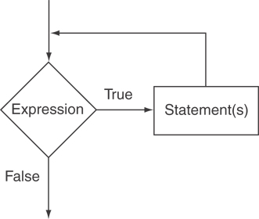
The Logic of a while Loop

Slide 11
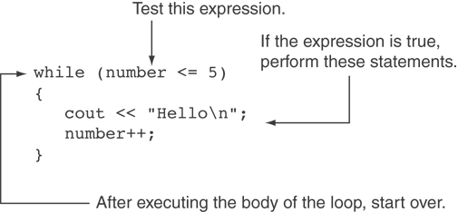
How the while Loop in Program 5-3 Lines 9 through 13 Works

Slide 12
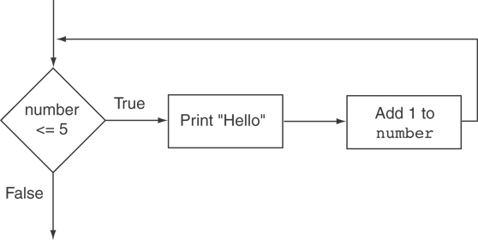
Flowchart of the while Loop in Program 5-3

Slide 13
The while Loop is a Pretest Loop
expression is evaluated before the loop executes. The following loop will never execute:
int number = 6;
while (number <= 5)
{
cout << "Hello\n";
number++;
}

Slide 14
Watch Out for Infinite Loops
The loop must contain code to make expression become false
Otherwise, the loop will have no way of stopping
Such a loop is called an infinite loop, because it will repeat an infinite number of times

Slide 15
Example of an Infinite Loop
int number = 1;
while (number <= 5)
{
cout << "Hello\n";
}

Slide 16
5.3
Using the while Loop for Input Validation

Slide 17
Using the while Loop for Input Validation
Input validation is the process of inspecting data that is given to the program as input and determining whether it is valid.
The while loop can be used to create input routines that reject invalid data, and repeat until valid data is entered.

Slide 18
Using the while Loop for Input Validation
Here's the general approach, in pseudocode:
Read an item of input.
While the input is invalid
Display an error message.
Read the input again.
End While

Slide 19
Input Validation Example
cout << "Enter a number less than 10: ";
cin >> number;
while (number >= 10)
{
cout << "Invalid Entry!"
<< "Enter a number less than 10: ";
cin >> number;
}

Slide 20
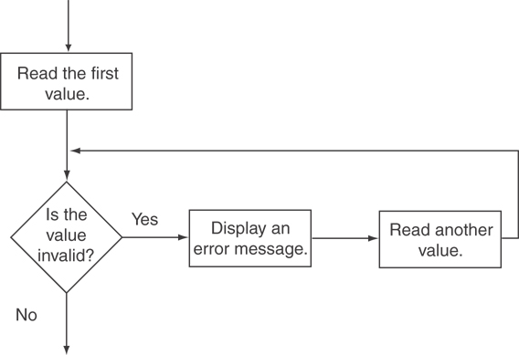
Flowchart for Input Validation

